Slide 1


MasterCare User Group
for Hospitals
Part of the
family
www.mastercare.net.au| www.global-health.com

Slide 2
Today’s agenda
TIME |  | PRESENTER
12:30pm – 12:40pm | Global Health introduction | Deborah Hudson
12:40pm – 12:45pm | Chairperson introduction | Nicky Ward
12:45pm – 1:05pm | Hospital accreditation requirements – Digital discharge summary and My Health Record | Nicky Ward
1:05pm – 1:25pm | MasterCare+ roadmap | Mathew Cherian
1:25pm – 1:55pm | MasterCare+ demo | Arpitha Suresh
1:55pm onwards | Other business | Deborah Hudson
www.mastercare.net.au | www.global-health.com

Slide 3

Today’s Chairperson
Nicky Ward
Admin Manager at Arcadia Pittwater Private Hospital
Nicky is a former Clinical Nurse Specialist in Orthopaedics. Since her nursing career, she has had extensive experience in Project and Product Management in the health software industry and has completed her Cert IV in Clinical Coding.
www.arcadiapittwater.com.au | www.global-health.com

Slide 4
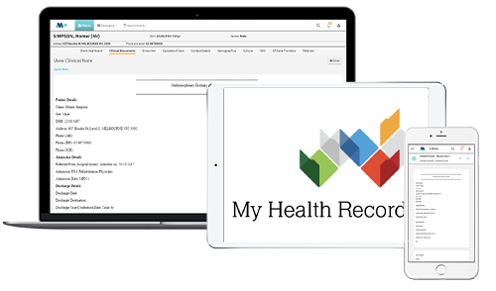
Hospital accreditation requirements
Digital discharge summaries
My Health Record
with Nicky Ward
www.mastercare.net.au | www.global-health.com

Slide 5


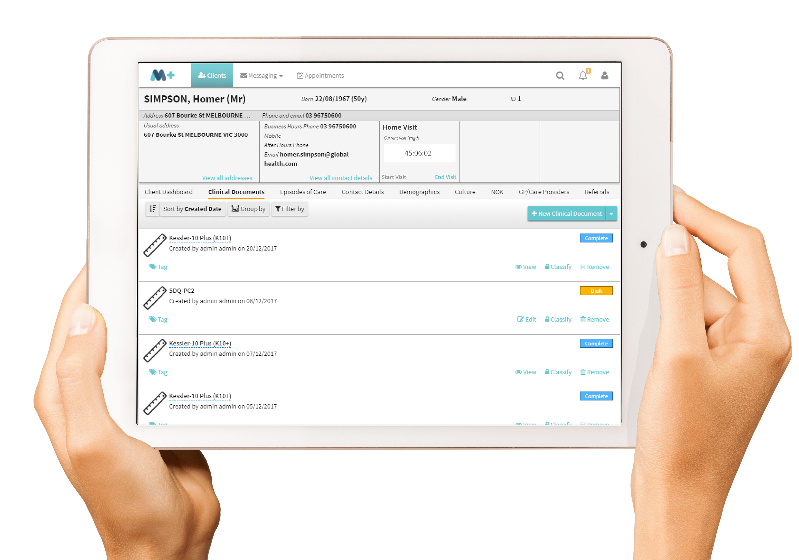
MasterCare+
Roadmap
with Mathew Cherian
www.mastercare.net.au | www.global-health.com

Slide 6




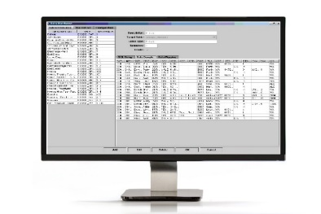
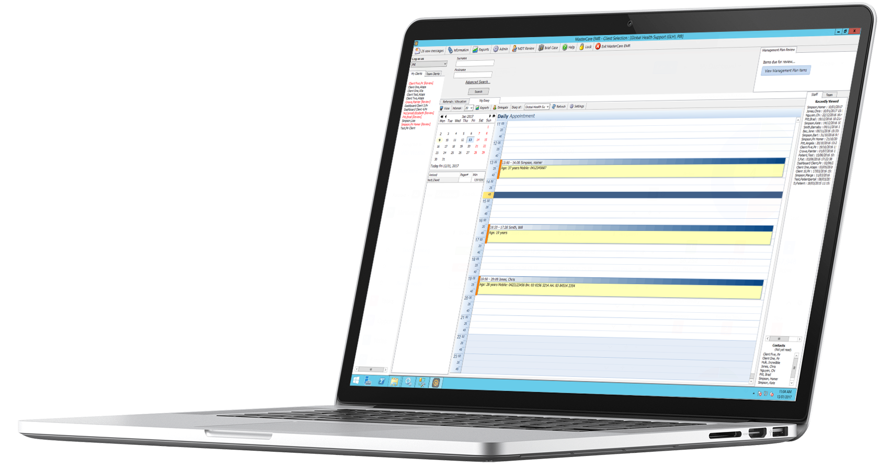
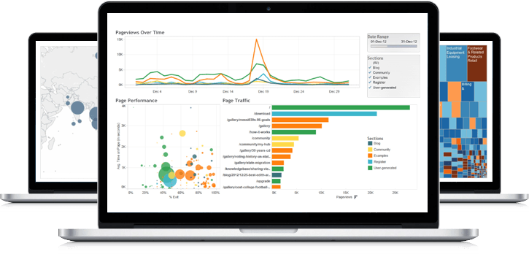
Current BAU is 4 different applications deployed in client / server mode
What is the next generation of healthcare apps ?
Practice & Clinical Management for GPs, Specialist and Allied Health practitioners.
Streamlined and defined work processes from pre-admission through to discharge or transfer for Day & Overnight hospitals
Team-based, multi-disciplinary care for patients with chronic diseases across hospitals, community health, outpatient and home settings
Business and clinical Insights into service activity, outcomes and efficacy of treatment plans for large organisations and funders of healthcare.
In 2014, we finalised our R&D road-map around “Streamlining the Patient Journey”
www.mastercare.net.au | www.global-health.com
Notes:
GLH has a wide range of enterprise software from
Primary and Allied Care
Mental Health and Chronic disease management
Hospitals
These products have been developed in the Australian Market which has internationally high healthcare standards and protocols. It is a market which has multiple payers, Medicare, DVA, Health Funds, etc, GLH's focus has been focussed on affordable healthcare software that improves productivity and efficiencies for healthcare providers and consumers. The increasing healthcare costs in Australia will exceed $200BILLION within 2 years and this represents a major opportunity for GLH to deliver software solutions that are affordable and can be upgraded on a continual basis to meet the growing demands of healthcare enterprises and consumers.

Slide 7















Streamline the Patient Journey
✓ Optimise the patient experience for our customers (Health Delivery Organisations or HDOs)
✓ Encourage patients to collaborate with their care team
✓ Healthcare services that can be delivered anytime, anywhere from any device
Secure Connectivity
Existing third party clinical and provider systems
Remote home monitoring devices and wearables
Health Provider Applications
Consumer Applications
Consumer Engagement
www.mastercare.net.au | www.global-health.com

Slide 8
Flexible design based on agreed, common standards
Module Provided by Global Health
Interoperability
Functional Module
Functional Module
UI Style & Services
Data Storage / Access
Tier #1
Tier #2
Tier #3
Functional Module
Functional Module
Security
Module Provided by External Company
  MS SQL and Orchard framework (dot.net) selected
www.mastercare.net.au | www.global-health.com

Slide 9
Modular Framework – recipes & bundles
Each functional module provides small loosely coupled additions to the system which can be bundled to suit specific market demands.
An example of some modules are:
Patient Demographics
Progress Notes
Template Services
Messaging
Claims & Payments
Scheduling
Care Planning
Prescribing
Ward Management
Waiting Lists
Orders & Results
Allergies
Theatre
Bed Management
Accident and Emergency
Coding
Rostering etc.
Progress
Notes
Patient
Demographics
Claims
& Payments
Address
Patient iD
www.mastercare.net.au | www.global-health.com
Notes:
Theatre
Bed management
Discharge summaries
Accident and Emergency
Pre-Admission
Coding
Billing
Rostering

Slide 10
An integrated and stacked solution designed to connect the Healthcare eco-system
All of the tools needed to easily add to and build for the perfect hospital solution
MasterCare PAS/EMR
An end-to-end fully integrated medical software solution which incorporates the entire process that a hospital requires and assists with the management of clinical and administrative hospital targets.
Patient Portal
Digitally capture patient information prior to their appointment without having to re-key information into your client database. Patient access the portal from anywhere at any time, so you have the accurate information and can focus on improving their health outcomes.
MasterCare+ Discharge Summaries
An fully digital solution which allows hospitals to generate, send and store electronic discharge summaries with structured data, and upload it to the My Health Record system. Easily integrates with your existing MasterCare PAS with the additional benefit of having discharge summaries.
MasterCare allows for implementation of different modules as per the hospital requirements, which can be rolled out in a phased approach.
E-Switch
The middleware to allow you exchange data externally, internally and between different software systems for optimum workflow efficiency and data accuracy.
www.mastercare.net.au | www.global-health.com

Slide 11

M+ 3 year roadmap for hospitals
2021
  M+ and PAS database synchronising rolled out
  Clinical Notes, inbound referrals, CDA Discharge Summary
  MyHealthRecord functionality
  ePrescribing Pathology Orders and Results
  Radiology Orders and Results using Secure Messaging
2022 - Dedicated M+ Hospital Engineering team established to migrate core PAS functionality to Plus
  Admission, Transfers & Separations
  Bed Management
  Theatre Management
  Medical Record Management (coding)
  Billing, receipting & accounting system integration
2023 onwards - Progressively migrate roles from PAS to M+
  Front Desk
  Ward
  Clinical
  Accounting
www.mastercare.net.au | www.global-health.com

Slide 12


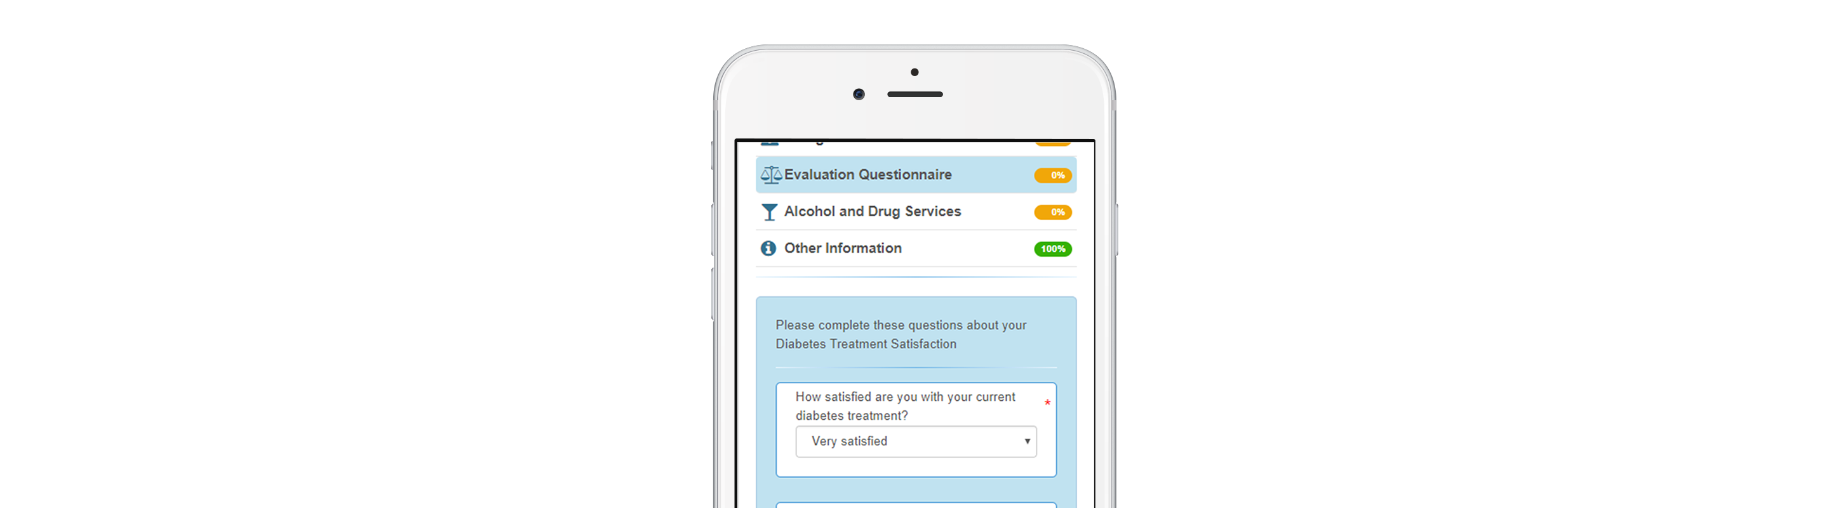





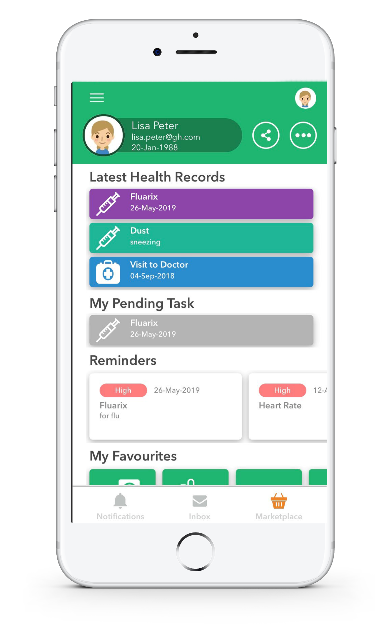





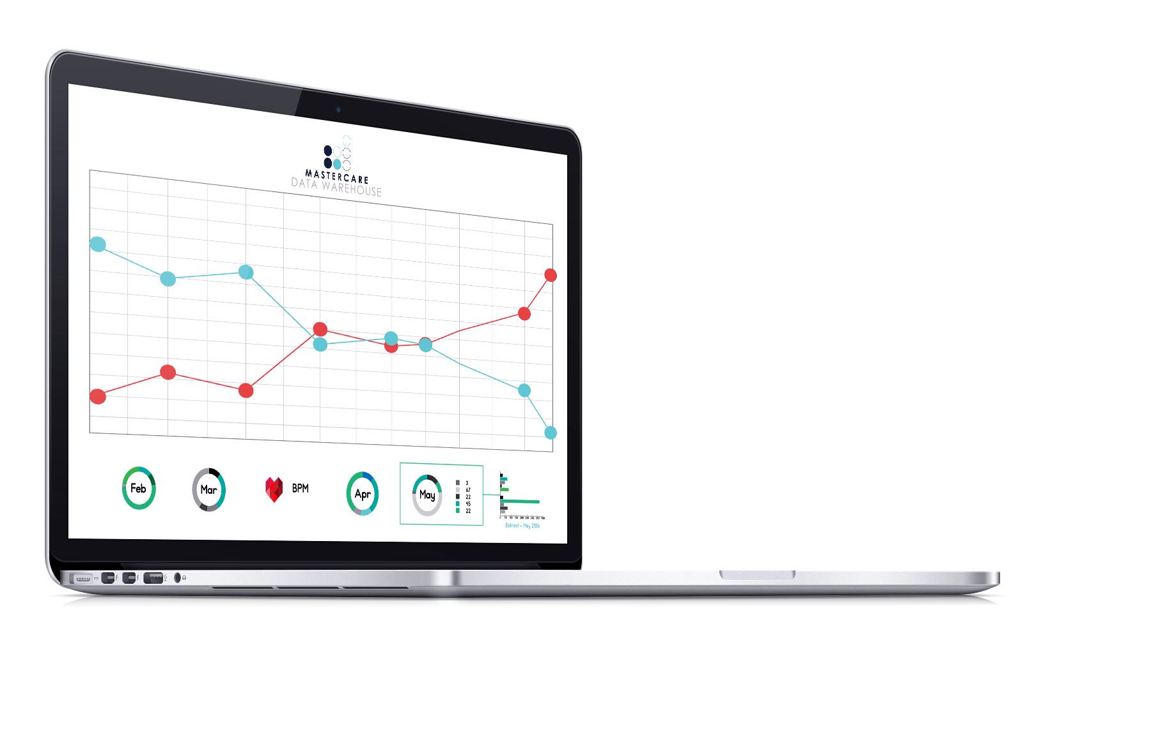

An integrated and connected workflow
Patient fills out digital pre-admission form.
Information saves to MasterCare PAS.
Specialist books theatre time from web-based platform.
Patient goes into theatre. Theatre touchscreen captures information.
Patient arrives for admission and is assigned a bed.
Discharge summary is sent to health providers and can be uploaded to MHR.
Patient has access to Lifecard Personal Health Record for post-hospital care.
Patient is billed and discharged.
MasterCare PAS data is analysed for clinical and business insights.
www.mastercare.net.au | www.global-health.com

Slide 13
MasterCare+
Demo
with Arpitha Suresh
www.mastercare.net.au | www.global-health.com

Slide 14
Topics Covered
Electronically prescribe to patients linked to PBS and add current medications
Create DS and upload CDA to MyHR
Adding client/patient in MC+ Alert about the Patient
Save clinical notes, Clinical documents
Customize Templates and add Logos
Please view the MasterCare+ demo
HERE
www.mastercare.net.au | www.global-health.com

Slide 15
Key features in MasterCare+
2-Way SMS (Appt reminders)
Secure Messaging Delivery
Capture Client Data
Send or Receive via ReferralNet Secure Messaging
Rostering and Appointments
Patient Administration
Clinical Management
Store unlimited documents scanned, images & referrals
Outcome Measure
Episode Of Care
Encounter
Upload and View My Health Record
Customize clinical Template
www.mastercare.net.au | www.global-health.com

Slide 16

Other business
Next user group session
www.mastercare.net.au | www.global-health.com

Slide 17

Thank you for your time
Helping our customers achieve improved performance and better patient care

